Slide 1


-: Project Report :-
-: OOPS Using Java :-
-: Professor : sir :-
-: Code: R1UC201C :-
Developed in Java
Systematized ATM Application
Date:-25/05/2025
Program:- Bachelor of technology, Computer Science of Engineering (Data science)
Section:- 44
Group members
Name: SAKSHI KUMARI Admission number: 22scse1420154 Email: sakshi.24scse1420154@galgotiasuniversity.ac.in
Name: MUSKAN PANDEY Admission number: 22scse1420147 Email: muskan.24scse1420147@galgotiasuniversity.ac.in
Name: MANGAL PANDEY Admission number:22scse1420126 Email: mangal.24scse1420126@galgotiasuniversity.ac.in
Name: HARSH THAKUR Admission number: 22scse1420162 Email: harsh.24scse1420162@galgotiasuniversity.ac.in

Slide 2
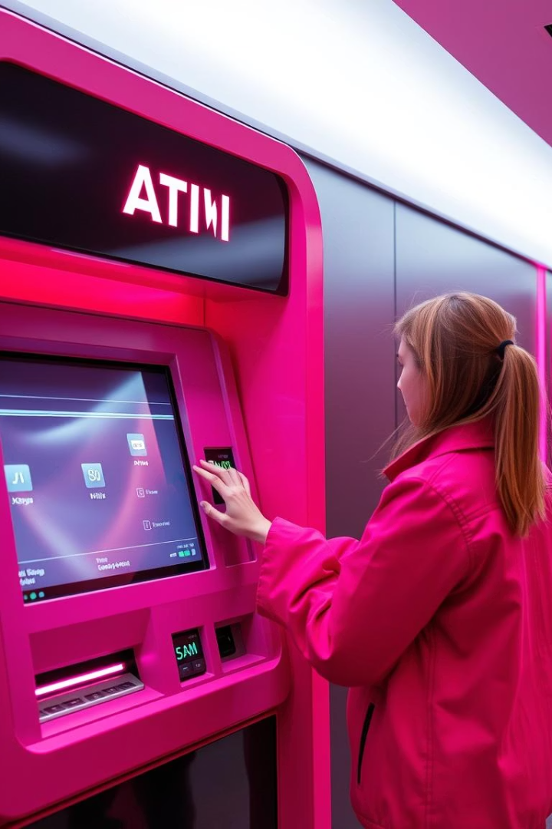
Introduction to the ATM Application
Simulation emulates a real-world ATM using Java technology.
Supports user authentication, balance checks, deposits, and withdrawals.
Designed for easy and secure banking transactions.

Slide 3
Technologies Used
Java JDK Latest Version
IDE: IntelliJ IDEA or Eclipse
Git for Version Control
Unit Testing Framework
Primary language powering the ATM simulation.
Professional development environment for coding efficiency.
Repository hosted on GitHub for collaboration and tracking.
Automated unit tests ensure core functions work properly.

Slide 4
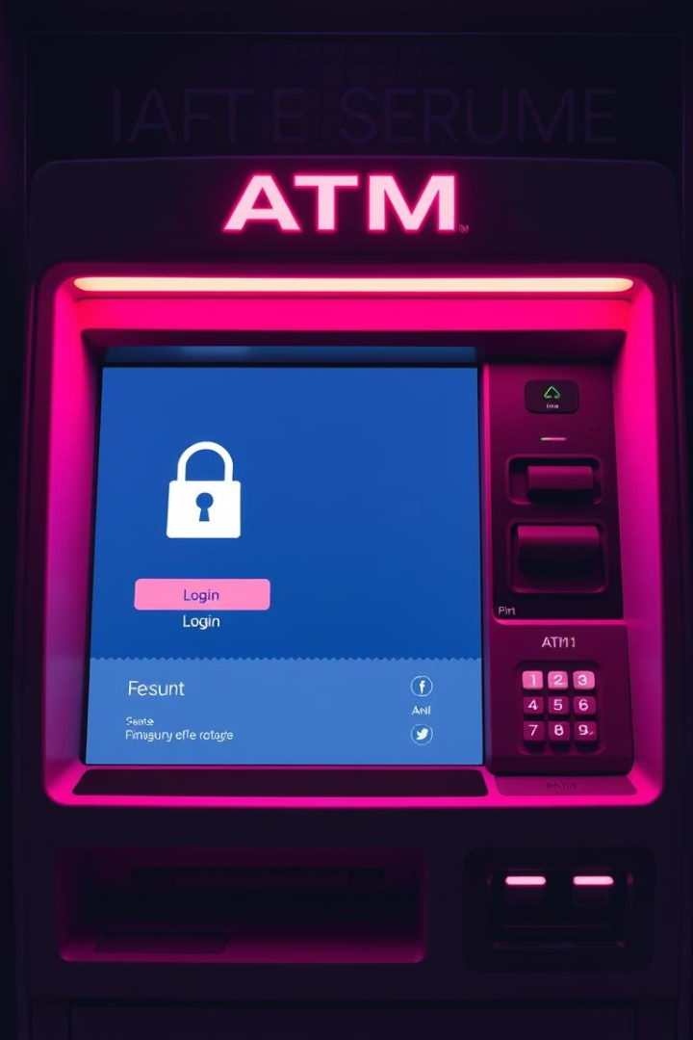
Core Functionalities - Authentication
Secure Login
PIN Security
User ID and PIN required for access.
MD5 hashing protects PINs in the database.
Lockout Feature
Account locked after three failed attempts to ensure security.

Slide 5
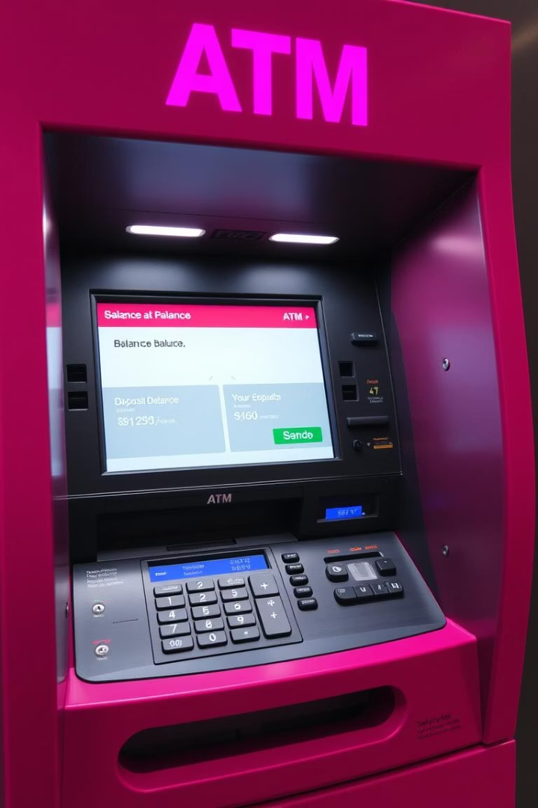



Balance Inquiry & Deposit
Real-time Balance
Instant display after login.
Deposit Function
Funds increase immediately with detailed transaction logs.
Transaction Limit
Maximum $10,000 per deposit transaction.

Slide 6
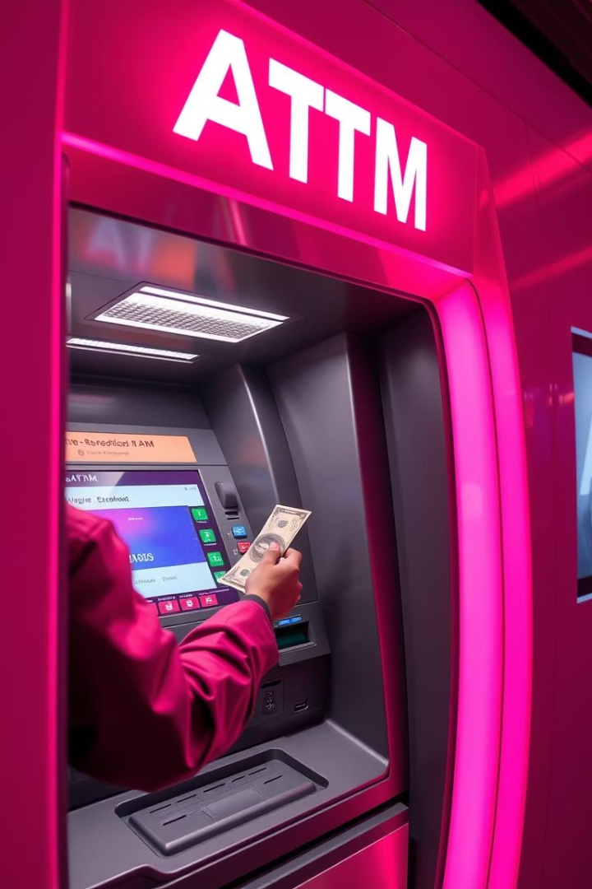
Withdrawal Features
Withdrawal Process
Balance decreases with transaction recording.
Limits Enforced
Minimum withdrawal $20; daily max $500.
Balance Protection
Account balance never dips below zero.

Slide 7





Live Demo
User Authentication
Secure login and validation.
Balance Inquiry
Check current account balance.
Deposit and Withdrawal
Show transaction handling and limits.
Error Handling
Test invalid input and edge cases.

Slide 8
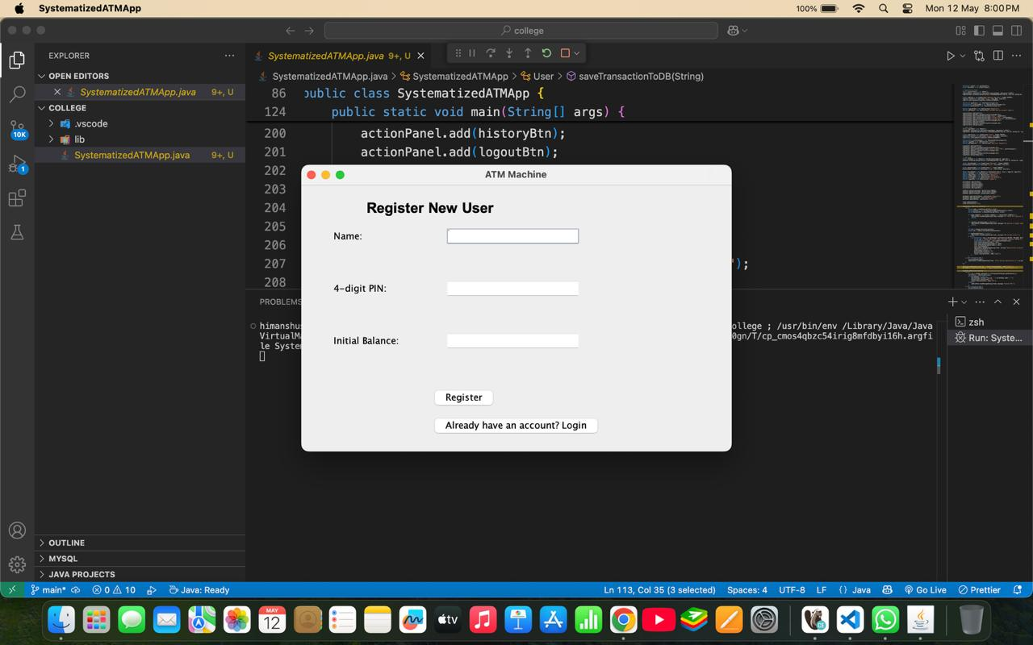
Step 1 :- Do you have account directly go to the login user otherwise, Register new user

Slide 9
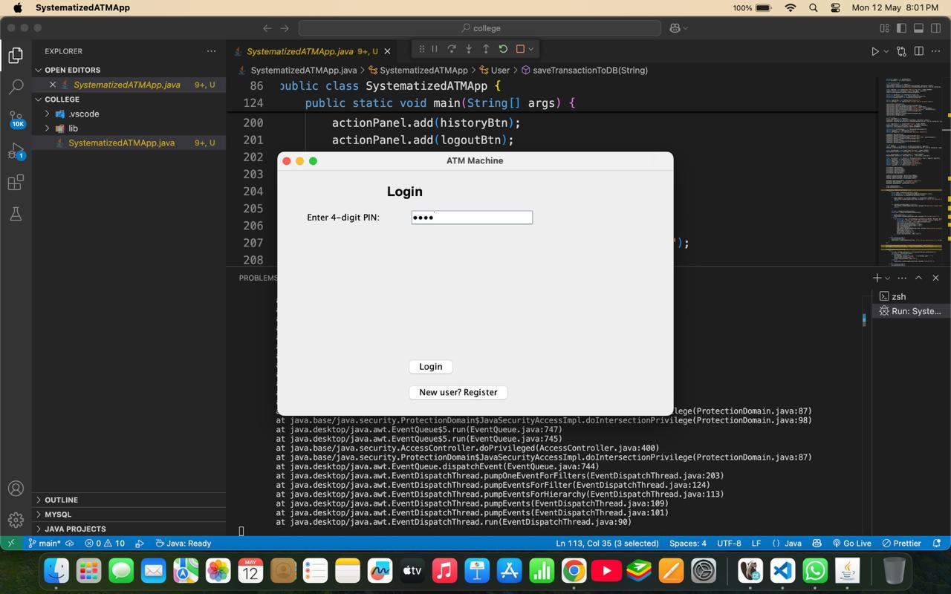
Step 2 :- you can directly login with your pin

Slide 10
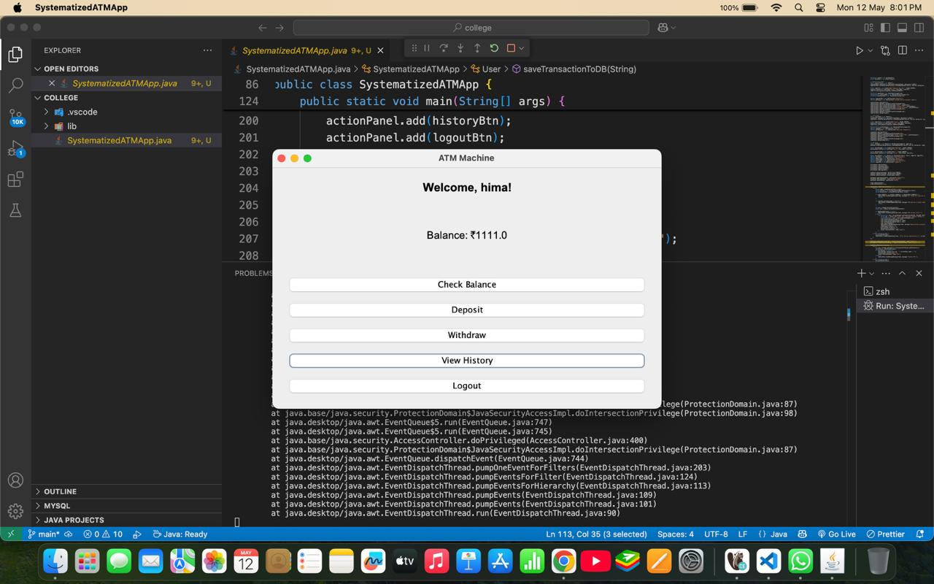
Step 3 :- You can perform action deposit, withdraw, check balance, view history, after compilation the action you can logout easily.

Slide 11
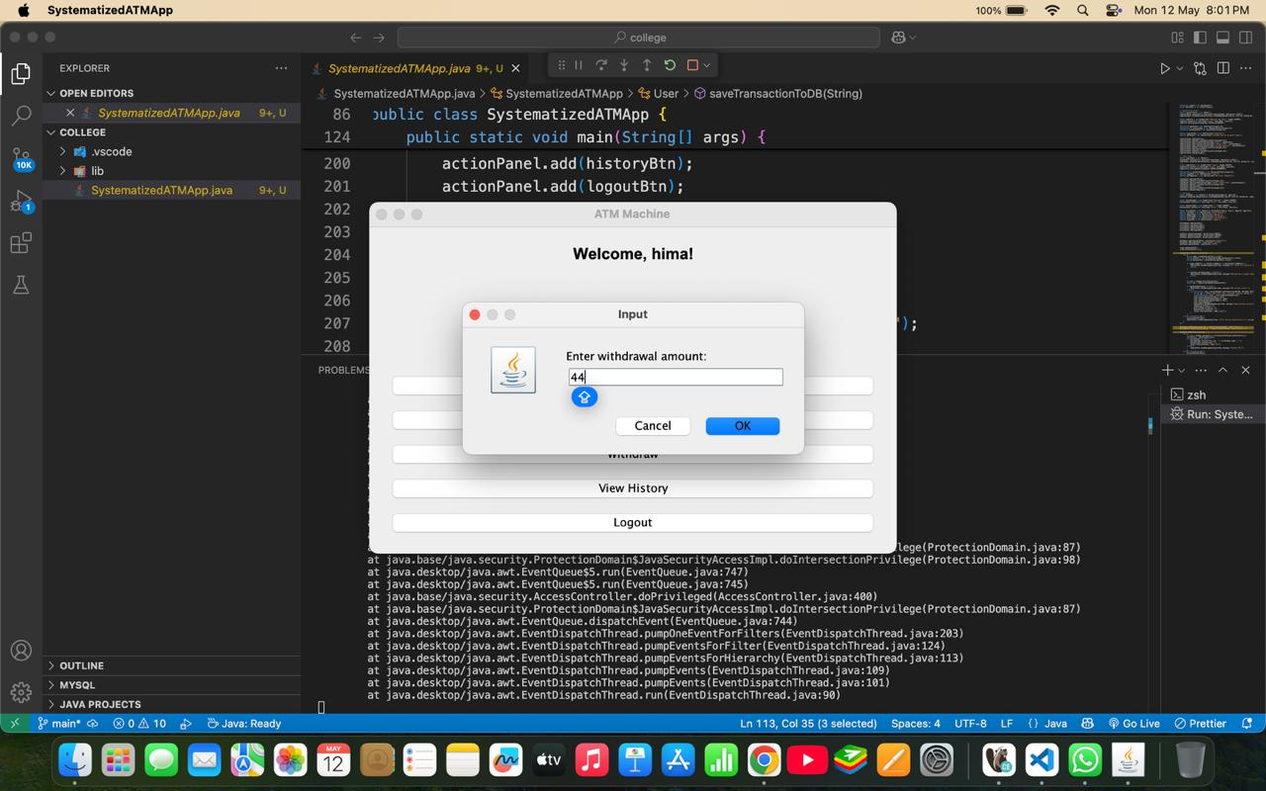
Withdrawal Amount

Slide 12
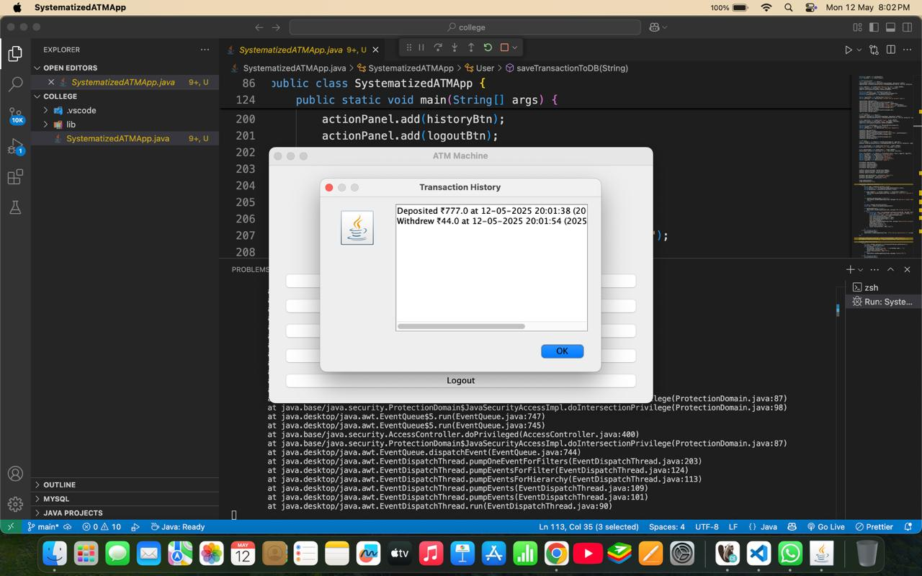
Transaction history

Slide 13
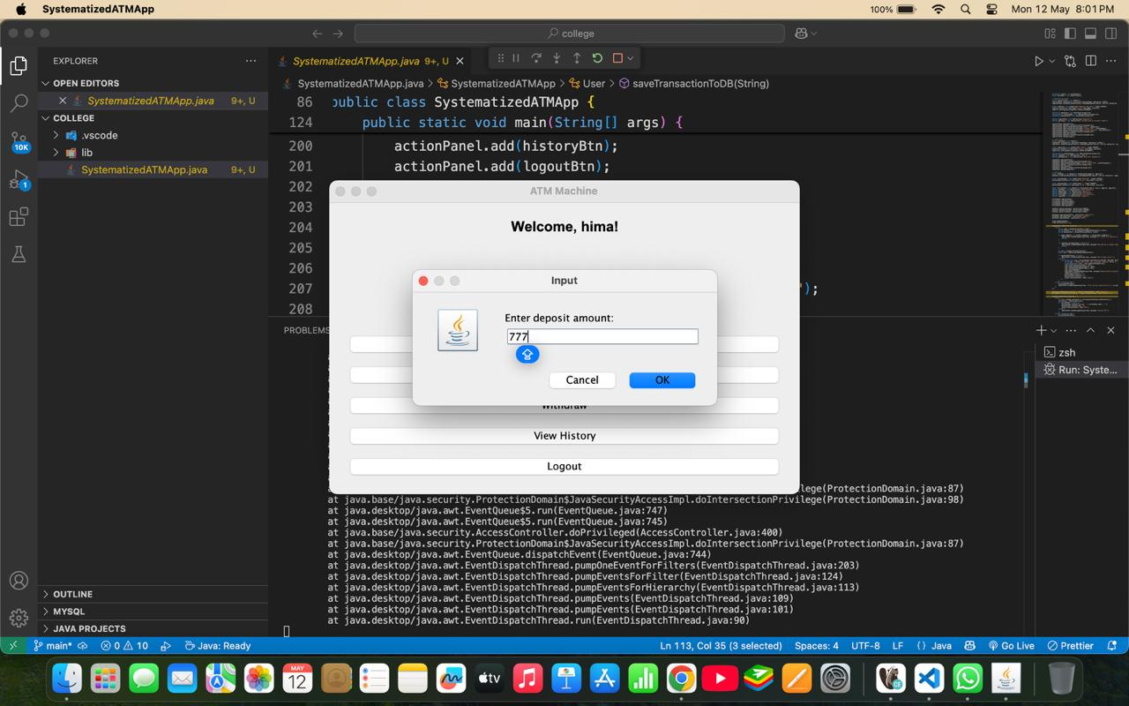
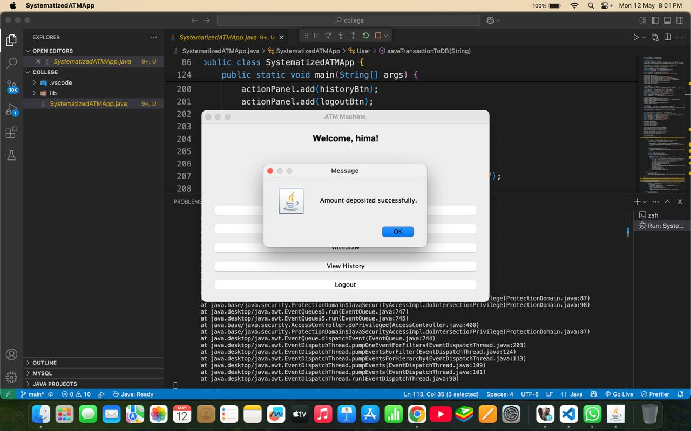
Deposit section

Slide 14
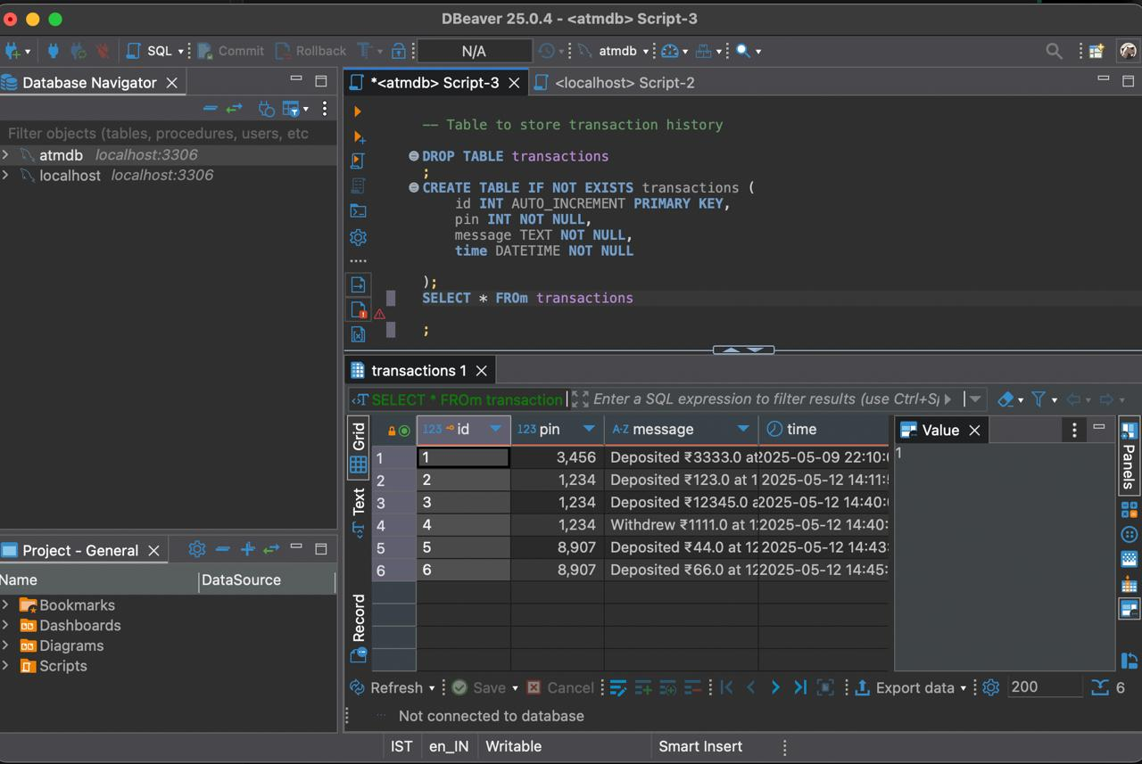
Database MySql

Slide 15
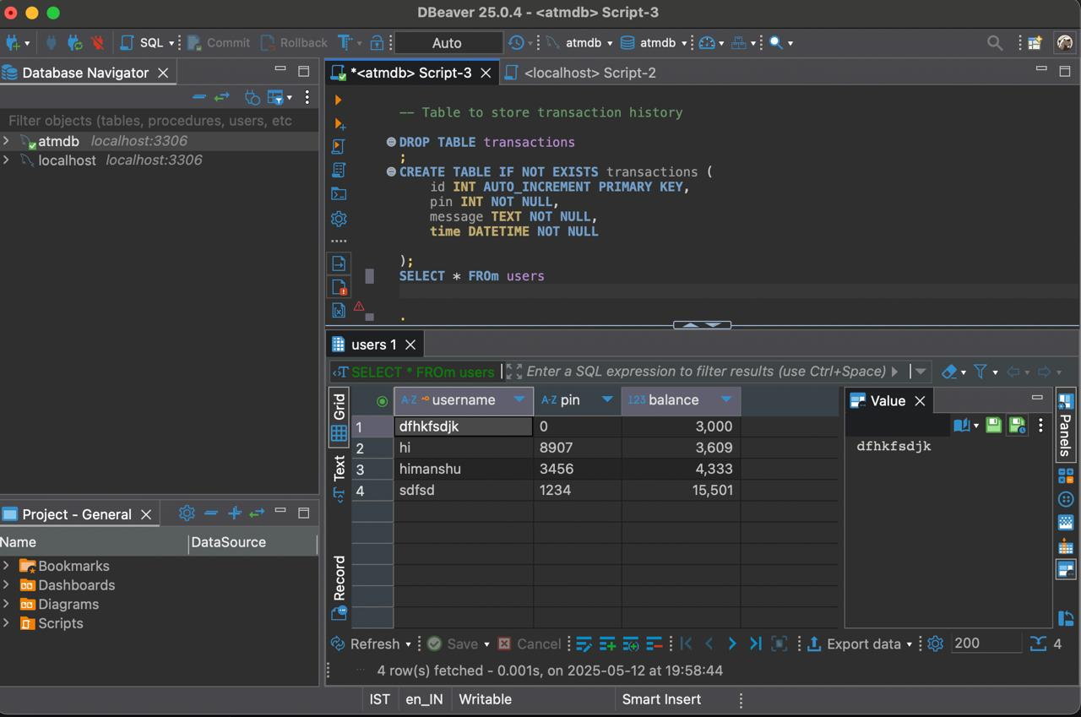
Database MySql

Slide 16
Conclusion & Future Plans
Secure Java ATM simulation fulfills banking essentials.
Plan for mobile app integration.
Introduce transaction fees management.
Provides real-time balance, authentication, and transactions.
Expand features for enhanced user experience.

Slide 17
Thank you

